Slide 1
RFID Solutions
i101 G37 | John Hasey, Chris Motia, Tyler Mayer, Zane Meiss

Slide 2
Introduction (Chris)
Discuss our problem; who is affected; what’s being done already? | give scenario

Slide 3
Research Findings
RFID security- Super important!
More advanced than ever
Protects sensitive data
Valuable for security/law enforcement
Crowd tracking
Data mining
Benefits with location services
Giveaways and raffles
More efficient and safer venues

Slide 4


Our survey mission
In order to gather data on our topic, we put together a short survey for college students that asked some general questions about the experiences they’ve had with music festivals and venues.

Slide 5
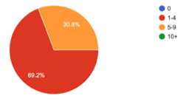
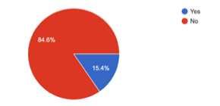
Number of music venues attended
The majority of those surveyed have gone to between 1 and 4 music venues
Music concerts and festivals are a common part of most college students lives
Of those, the majority have never won anything.
This could be due to absence of effective giveaways or disorganization of existing giveaways
Won anything at a venue?

Slide 6
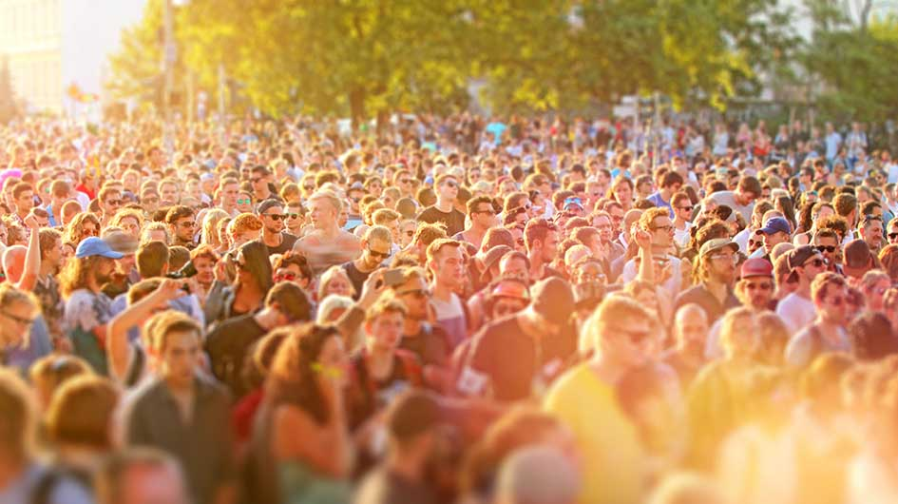
Crowding and Long Waits

Slide 7
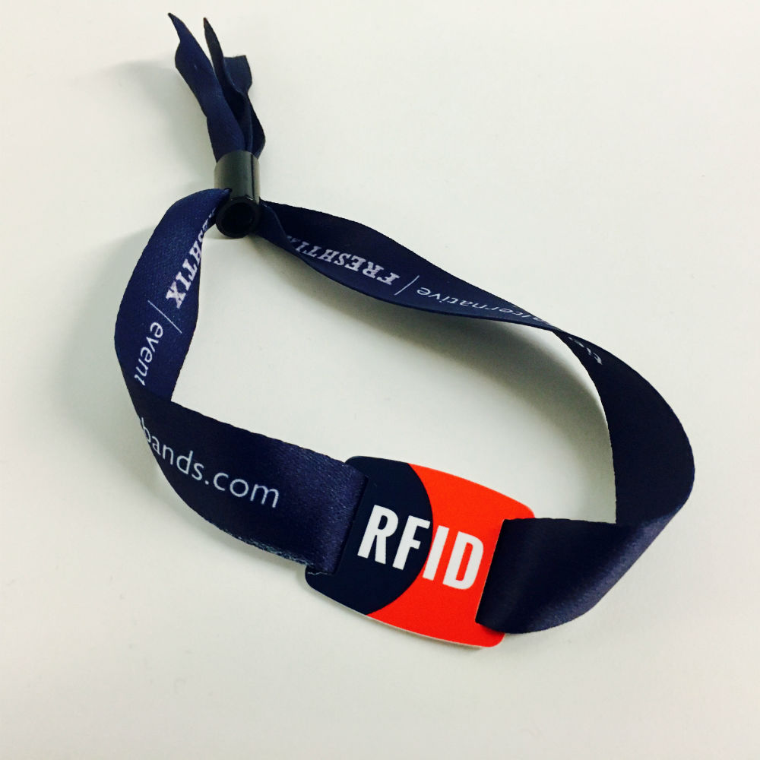
Solution
Our solution is based off someone else's design but we’ve added a few features in order to make giveaways easier
We added your apparel size, and medical information
When going into different stage areas you check in at that stage allowing concert organizers to narrow down the amount of people in that give away
Our target market is concert organizers and planners large facility owners
Concert goers will enjoy this system due to the added safety features as well as the shortening of lines getting into festivals
Cashless system, tracking of shipping

Slide 8
Conclusion (Chris)

